Slide 1
Drone Dataset Data Analysis & Visualization
Kaggle Drone dataset contains 1000 uncategorised images and a final_example.csv file.

Slide 2
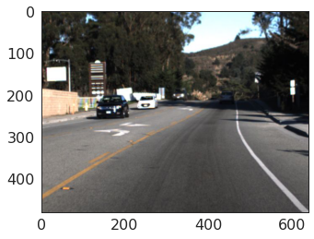
Plotting an image from the dataset
This image contains two cars & traffic lights.
So, the size of every single image in the dataset is (480, 640, 3) pixels.

Slide 3
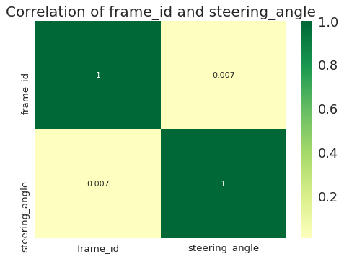
Correllogram
Correlogram is used to visually see the correlation metric between all possible pairs of numeric variables in a given dataframe (or 2D array).
The correlation between frame_id & steering_angle is 0.007 which means there is alomost no correlation.

Slide 4
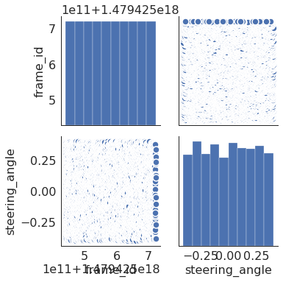
Pairwise Plot
Pairwise plot is a favourite in exploratory analysis to understand the relationship between all possible pairs of numeric variables. It is a must have tool for bivariate analysis.
frame_id has a constant distribution, however steering_angle showed some fluctuations.

Slide 5
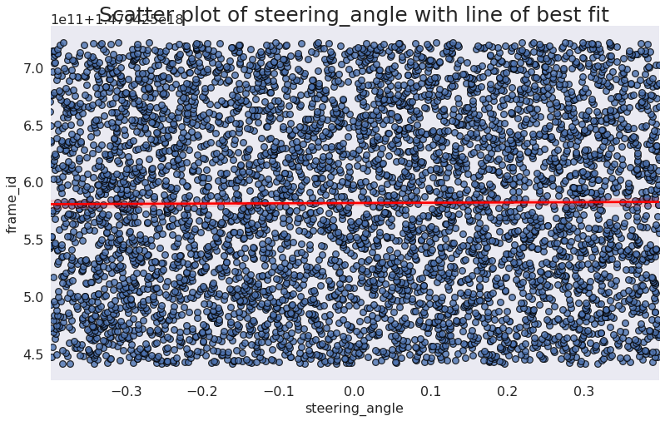
Scatter plot with linear regression line of best fit
Used to understand how two variables change with respect to each other, the line of best fit is the way to go. The below plot shows how the line of best fit differs amongst various groups in the data. To disable the groupings and to just draw one line-of-best-fit for the entire dataset, remove the hue='cyl' parameter from the sns.lmplot() call below.
Scatterplot with line of best fit suggests that there is no linear regression present in steering_angle.

Slide 6
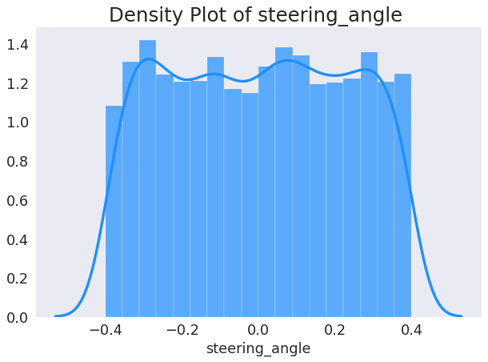
Density Curves with Histogram
Density curve with histogram brings together the collective information conveyed by the two plots so you can have them both in a single figure instead of two.
The density plot of steering_angle is almost constant but also little bit fluctuating.

Slide 7
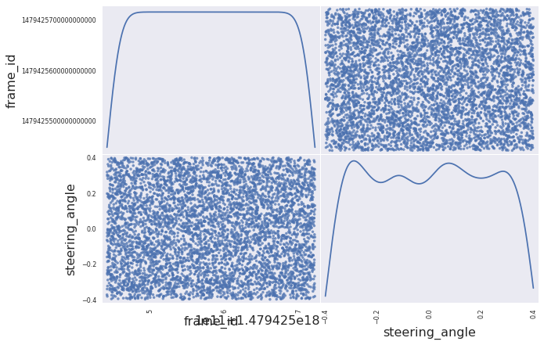
Scatter and Density plot
The Scatter plots of steering_angle & frame_id are not showing any essential information. Besides, the frame_id's density plot is constant, however steering_angle's density plot is little bit fluctuating.

Slide 8
Mean, Median, and Mode of steering_angle
Mean: 0.000487757865425786
Median: 0.00680191526189447
Mode: -0.39974693
Mode represents that steering_angle -0.39974693 got repeated the most at that particular road location which means the exact angle of road at that moment would be approximately negative 40%.

Slide 9
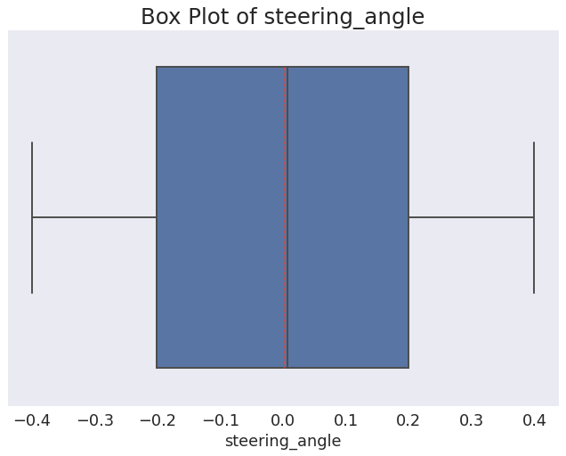
Outliers
Noise and exceptions in the data.
This Boxplot does not contain any outlier which means this data doesn't contain any unexpected value that can modify the resultant values. So, no need of data transformation.

Slide 10
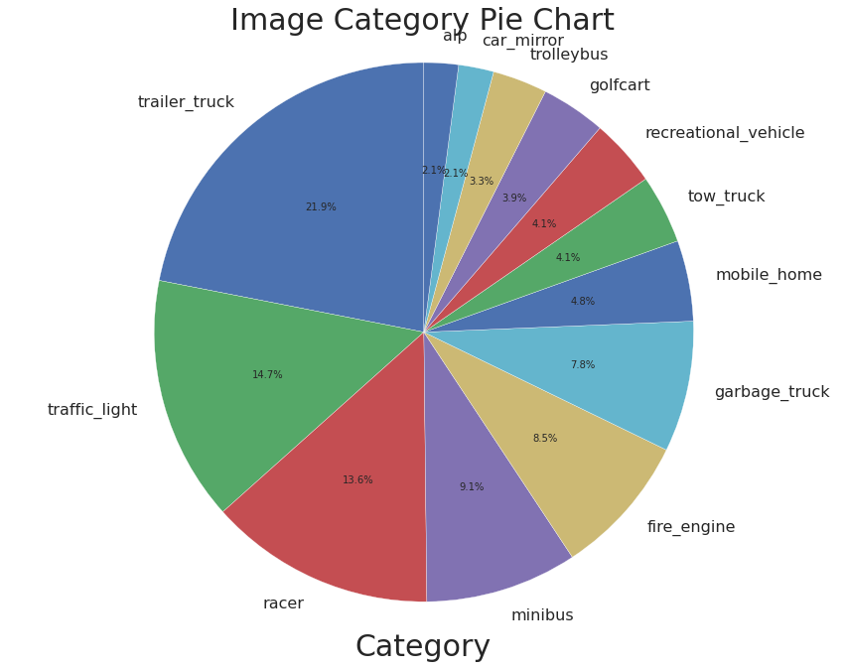
Top-most Prediction Result of all images
The density plot of steering_angle is almost constant but also little bit fluctuating.

Slide 11
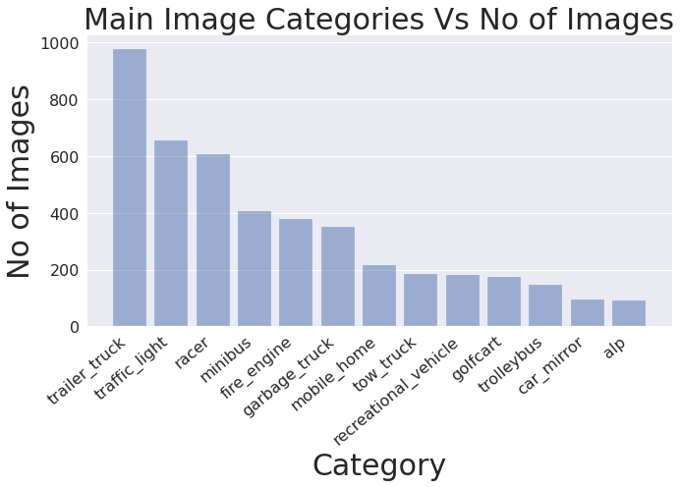
Top-most Prediction Result of all images
Conclusion:
Therefore, the top 6 predictions are trailer_truck, traffic_light, racer, minibus, fire_engine, garbage_truck.

